Slide 1

Sensors and Transducers
Military Institute of Science and Technology
Department of Computer Science and Engineering
Course Name: Computer Interfacing
Course Code: CSE-405

Slide 2

Book Reference
❏ Microprocessor and Interfacing- Douglas V. Hall (Chapter 10)

Slide 3
Introduction
A sensor is a physical device that detects or senses changes in any physical quantity or energy- heat, light, pressure, humidity, motion
A sensor’s output is analog in nature.
Active sensors can power themselves (eg, piezoelectric crystal), whereas passive sensors require external power.
A transducer is a physical device that converts one form of energy into another.
Electrical transducer converts other forms of energy into an electrical signal.
Transducer is made of a sensor and a signal conditioning circuit.
A transducer can generate analog as well as a digital output.

Slide 4
Types of sensors
Light Sensors:
Photodiode
LDR
Solar Cell
Force Sensors:
Strain Gauge
Load Cell
Pressure Sensors
Pressure Gauge
Manometer
LVDT
Temperature Sensors:
RTD
Thermistor

Slide 5

Light Sensors

Slide 6
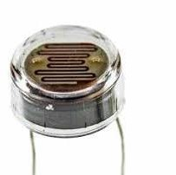
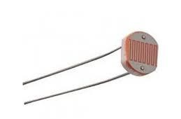
Light Dependent Resistor (LDR)
A glass window allows light to fall on a zigzag pattern of cadmium sulfide whose resistance depends on the amount of light present
Resistance vary from 15 MΩ (in dark) to 15 kΩ (in bright light)
Advantages-
Inexpensive
Durable
Sensitive
Disadvantages
Photoresistor have very slow response time
Not stable with temperature
May get damaged if temperature gets too high
Application : light measurement need not be precise- e.g- streetlight

Slide 7
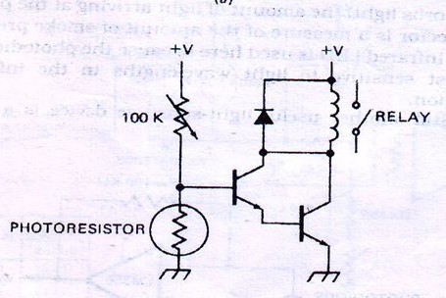
LDR—Working Principle in Streetlight
Streetlight contain a photoresistor, a transistor drive and a mechanical relay
In the dark, resistance of photoresistor goes up
Increases the voltage on the base of the transistor
The transistor turns on
Turns on relay
Switches on the lamp

Slide 8
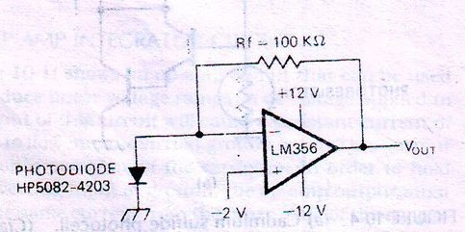
Photodiode
Light is allowed to fall on the junction of a specially constructed silicon diode.
Reverse leakage current increases linearly as the amount of light increases
Leakage current is converted into proportional voltage
This can be used for smoke detection.
Put gallium arsenide infrared LED on one side and photodetector circuit on the other side or the smokestack
Smoke absorbs light- the amount of light arriving the photodetector is the measure of smoke.
Infrared LED is used—photodiode is more sensitive to light wavelength in the infrared region.

Slide 9
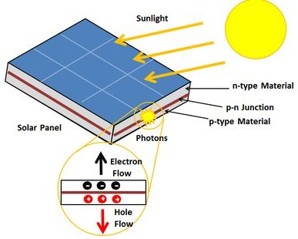
Solar Cell
Very heavily doped silicon PN Junctions
Light shining on the solar cell causes a reverse current to flow.
Solar cells can be connected in series and parallel array to produce a solar power supply

Slide 10
Temperature Sensors

Slide 11
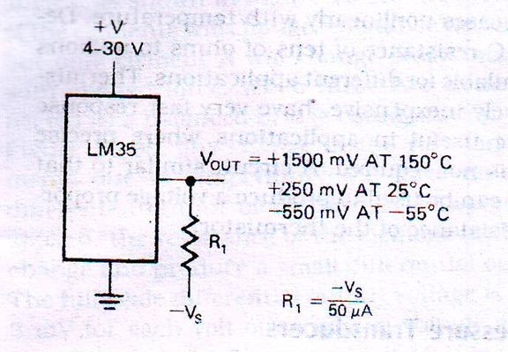
Semiconductor Temperature Sensors
Two types of semiconductor temperature sensors
Temperature-Sensitive Voltage Sources
Temperature-Sensitive Current Sources
Temperature-Sensitive Voltage Sources
Example: LM35
Voltage output increases by 10 mV for each degree celsius in temperature increases
Output adjust to 0 V for 0° C.
Sensor gives output for temperature range of -55° to +150°C

Slide 12
Thermocouples
A thermocouple is a junction between two different metals that produces a voltage related to a temperature difference.
When two different metals are put in contact ,a small voltage is produced between them—the Seebeck effect
Developed voltage depends on
Type of metals used
Temperature
The developed voltage increases between 7 and 75 µV for each degree celsius increase in temperature- depending on the metal
A thermocouple junction made of iron and constantan is called a type ‘J Thermocouple’
Temperature range : -184 to +760 degree Celsius
Thermocouple junction can be made of platinum and alloy of platinum-rhodium
Temperature range : 0 to 1600 degree Celsius

Slide 13
Thermocouples - 3 main problems
1. Output is very small and need to be amplified a great deal
2. A reference junction of same metal must be connected in series with the junction used to make the measurement
Because thermocouple reading is meaningless without comparing it to another, more accurate temperature sensor, usually a reference
The difference between the voltages across the two thermocouples goes as input to the amplifier
It's impossible to tell which thermocouple is causing a change in voltage if both temperatures are changing.
One end of the thermocouple—the hot junction—is thermally attached to the object to be measured
The other end of the thermocouple—the cold junction—is placed into an ice bath to hold it at a constant temperature

Slide 14
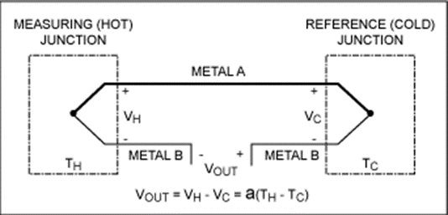
Thermocouples - 3 main problems
3. Output voltages do not change linearly with temperature
Analog circuitry is needed which changes the gain of an amplifier according to the value of the signa

Slide 15
Thermocouple math problem
Suppose the measured output voltage between measuring junction and reference junction using thermocouple is 3.41mV. Reference junction temperature is 22 C.
What will be the temperature of the measuring junction? ^{Also find the seebeck}

Slide 16
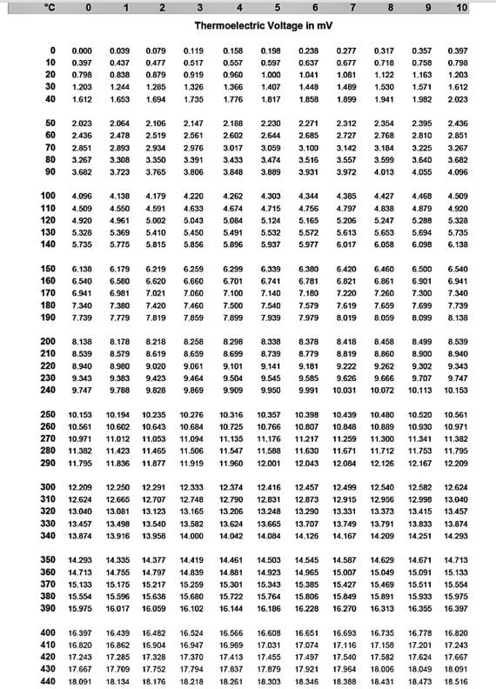


Slide 17
Thermocouple math problem
Suppose the measured output voltage between measuring junction and reference junction using thermocouple is 3.41mV. Reference junction temperature is 22 C.
What will be the temperature of the measuring junction? ^{Also find the seebeck}
We know, Vout = Vh - Vc
Vout = a (Th - Tc)
Vout=3.41mV
Tc=22 degree C Th=?
a=?
From table,
When T=22 C, V=0.879 mV So, Vc=0.879 mV
Thus, Vout=Vh-Vc
3.41=Vh-0.879 Vh=4.289mV
So, From table, when V=4.289 approx., T= 104 or 105 C So, Th= 105 (4.289 close to 4.303 thann 4.262)
So, a=3.41/(105-22) = 0.0411

Slide 18
Resistance Temperature Detector (RTD)
Resistance Temperature Detector is another commonly used Temperature Sensor
It is actually a resistor which change value with a change in temperature
It consists of a wire or a thin film of platinum or a nickel wire
Response of RTDs is non-linear but they have excellent
Stability (This is the sensor's ability to maintain a consistent output when a constant input is applied)
Repeatability (is the sensor's ability to give the same output or reading under repeated identical conditions.)
It is useful for measures in the range of -250 to +850° C
The resistance of an RTD increases with an increase in temperature
Change in the resistance is converted into a proportional voltage
Used where precise temperature measurement is needed

Slide 19
Thermistor
Thermistors consists of semiconductor materials
Resistance decreases nonlinearly with temperature
Relatively inexpensive
Very fast response time
Applicable where precise measurement is not required

Slide 20
Force and Pressure Sensors

Slide 21
Strain Gages
It is a small resistor whose value changes when its length is changed
It is made of thin wire, thin foil or semiconductor material
One end of a piece of spring steel is attached to a fixed surface
A strain gage is glued on the top of the flexible bar
The force or weight to be measured is applied to the unattached end of the bar
As the applied force bend the bar, the strain gage is stretched, increasing its resistance
Since the amount that the bar is bent is directly proportional to the applied force
The change in the resistance will be proportional to the applied force

Slide 22
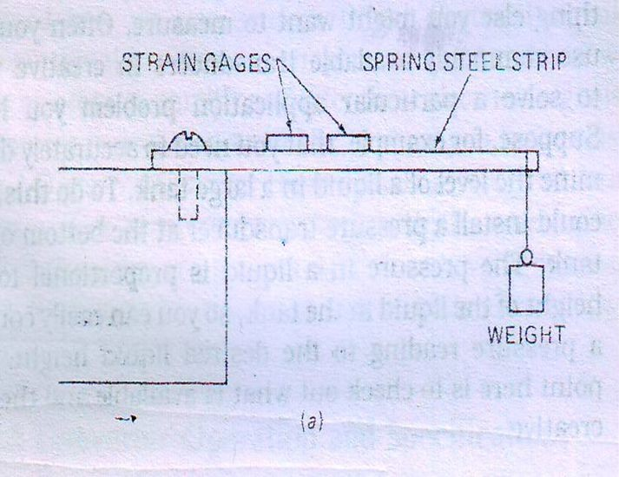
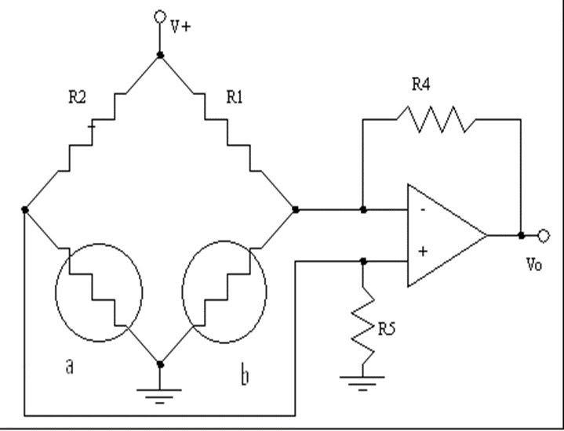
Strain Gages
If current is passed through the strain gage, then the change in voltage across the strain gage will be proportional to the applied force
Unfortunately the resistance of strain gage element also changes with the temperature
Two Strain gage elements are mounted at right angles
If the elements are connected in a balanced –bridge configuration, any change in the resistance due to temperature will have no effect on the differential output of the bridge

Slide 23
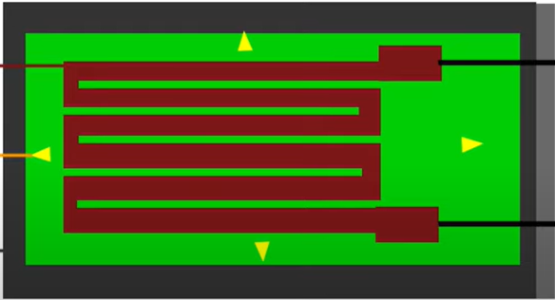
Strain Gages

Slide 24
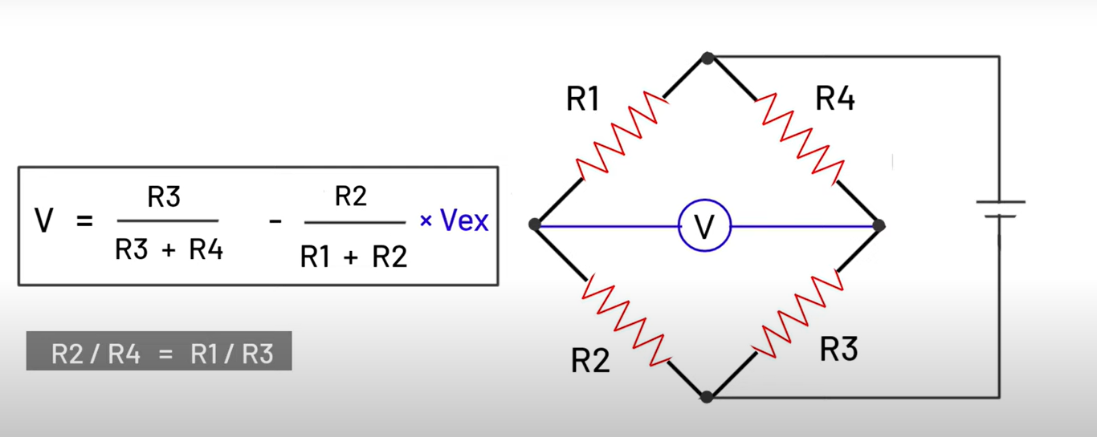
Strain Gages

Slide 25
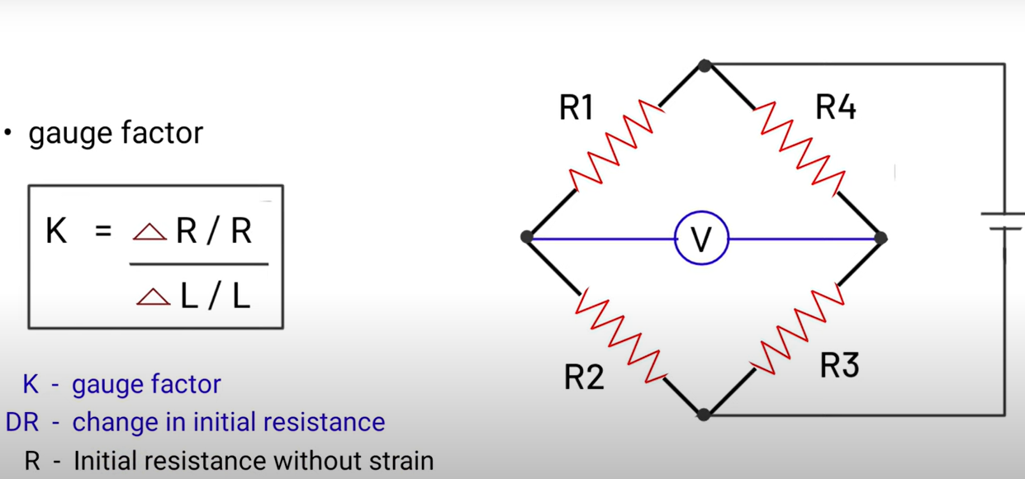
Strain Gages

Slide 26
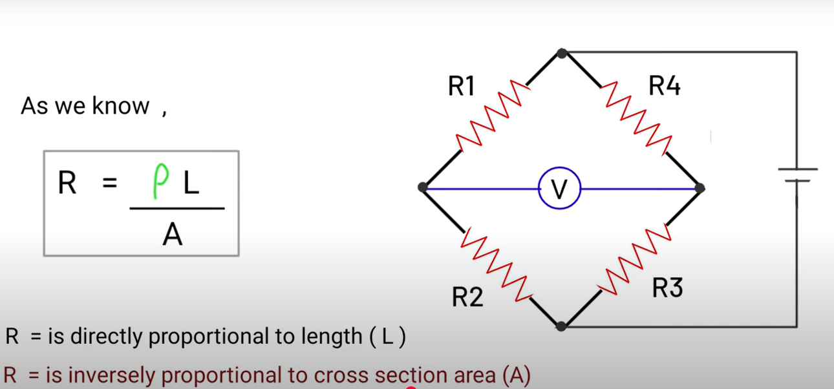
Strain Gages

Slide 27
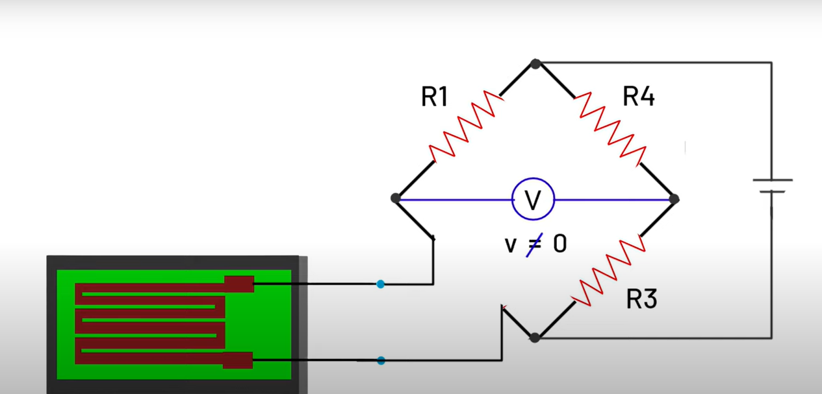
Strain Gages

Slide 28
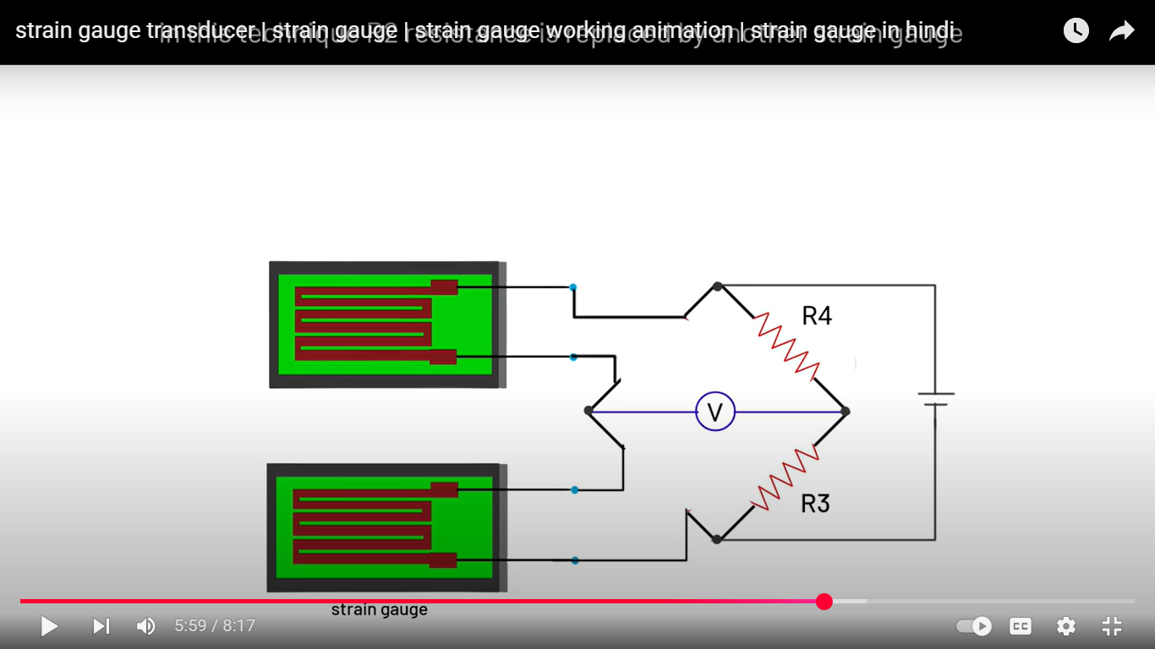
Strain Gages

Slide 29
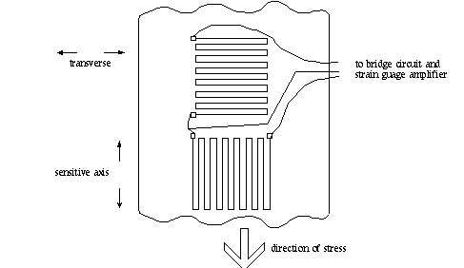
Strain Gages

Slide 30
Math
For a balance bridge: stretch resistor are 4Ω and compressed resistor are 2Ω. Vin is 5V. Find Vout.

Slide 31
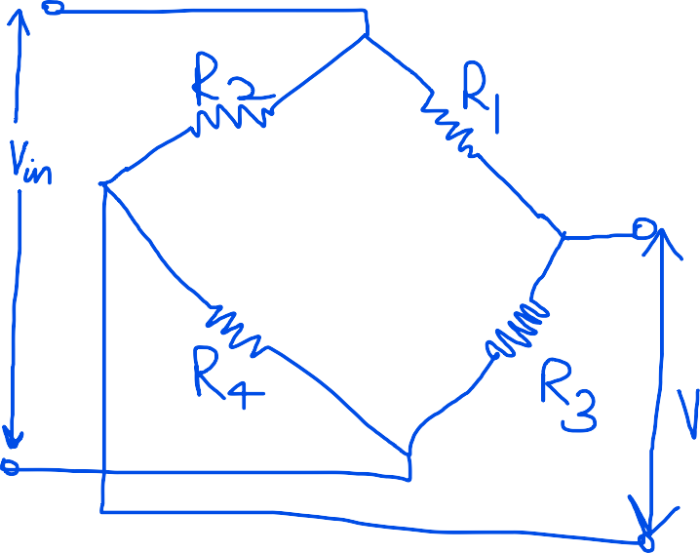
Math
For a balance bridge: stretch resistor are 4Ω and compressed resistor are 2Ω. Vin is 5V. Find Vout.
Vo = [ (R4 / R4+R2) - (R3 / R3+R1) ] * Vin
Here, R4 > R3
R1,R4 is a pair. R2,R3 is a pair. If one of the pair are the compressed resistors, then the other are stretched resistors. Stretched resistors have greater resistance than the compressed ones.
If R1=R4 and R2=R3, then
Vo = [ (stretched / stretched+compressed) - (compressed / stretched+compressed) ] * Vin
So, from the question,
Vo = [(4/ 4+2) - (2 / 4+2)] * 5 = 1.67V

Slide 32
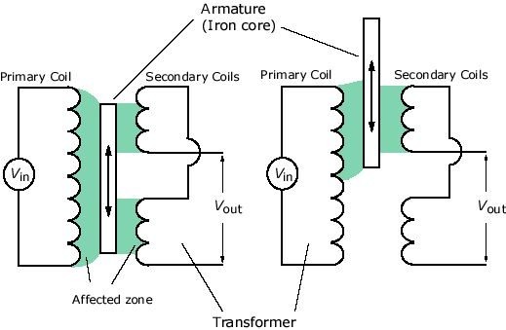
Linear Variable Differential Transformers
The phase relationship between the output signal and the input signal is an indication of which direction the core moved from the center position.
The amplitude of the output signal is linearly proportional to how far the core moves from the center position.
Thus an LVDT can be used directly in this form to measure displacement or position.
If we add a spring so that a force is required to move the core, then the voltage out of LVDT will be proportional to the force applied to the core.
Es1=Es2
So Vout=0
Es1>Es2
So Vout = 0

Slide 33
Linear Variable Differential Transformers
LVDT is a transducer often used to measure force, pressure or position
Basic structure of an LVDT consists of
Three coils of wire wound (1 Primary, 2 secondaries).
A movable iron core (armature).
An ac excitation signal of 20 kHz is applied to the primary.
The secondaries are connected in opposition such that the voltage induced in one opposes the voltage induced in the other.
If the core is centered , then the induced voltages are equal and cancel each other.
So there is no net output voltage.
If the coil is moved off center, coupling to one secondary coil will be stronger, so that the coil will produce a greater output voltage.
Result- a net output voltage.

Slide 34
Flow Sensors

Slide 35
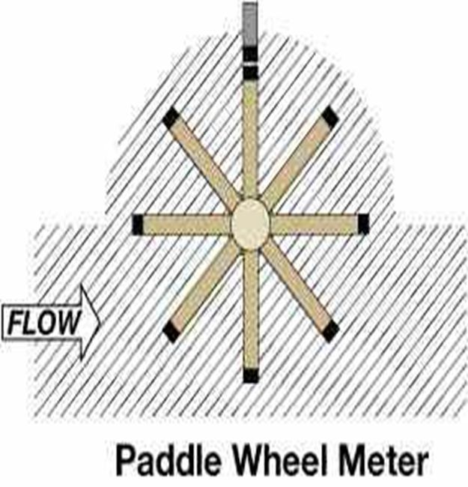
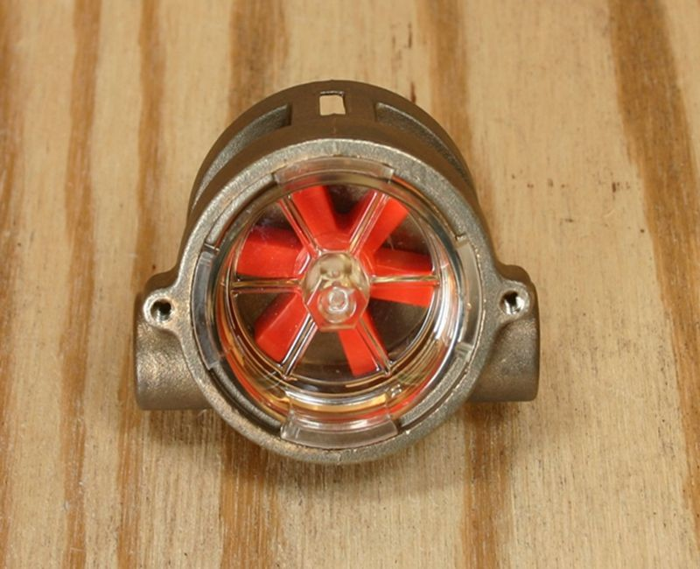
Paddle Wheel
We can use a paddle wheel in the flow.
The rate at which the paddle wheel turns is proportional to the rate of flow of a liquid or gas.
An optical encoder can be attached to the shaft of the paddle wheel to produce digital information as to how fast the paddle wheel is turning.
Optical encoder converts motion into a sequence of digital pulses.

Slide 36
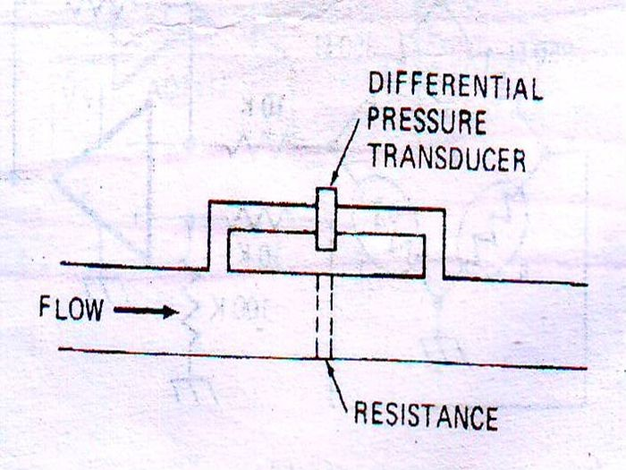
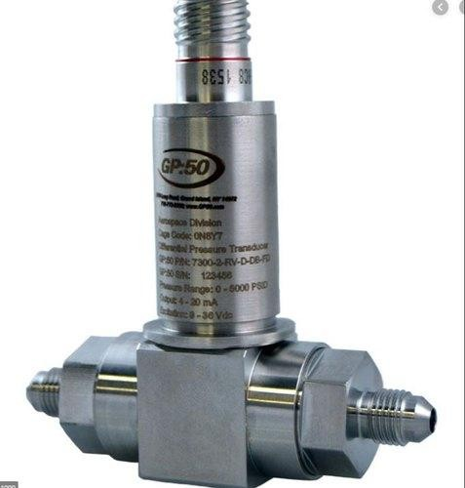
Differential pressure Transducer
A wire mesh or screen is put in the pipe to create some resistance.
Flow through this resistance produces a difference in pressure between the two sides of the screen.
The pressure transducer gives an output proportional to the difference in the pressure between the two sides of the resistance.
Thus the output of a pressure transducer is proportional to the flow of a liquid or gas through the pipe.

Slide 37
Thank You

